Slide 1
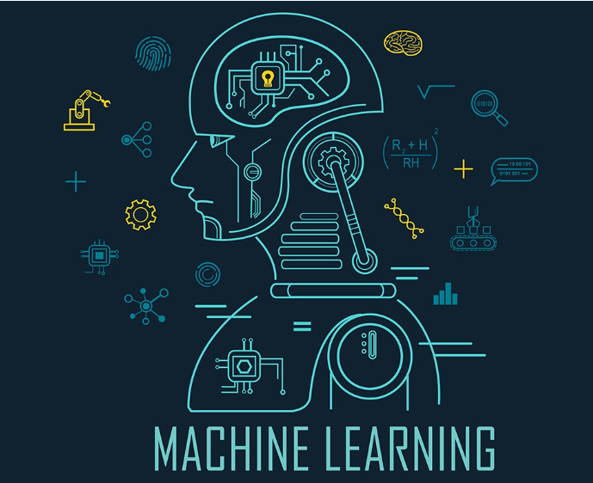
Machine Learning

Slide 2
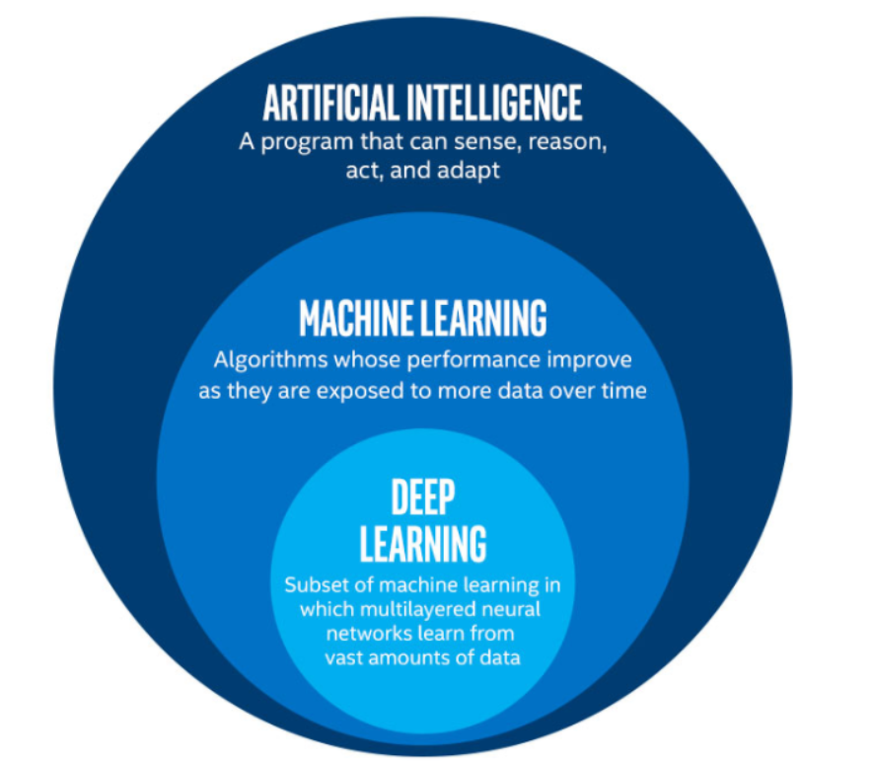
What exactly is machine learning..?
Machine learning is a sub-category of artificial intelligence and effectively automates the process of analytical model building and allows machines to adapt to new scenarios independently.

Slide 3
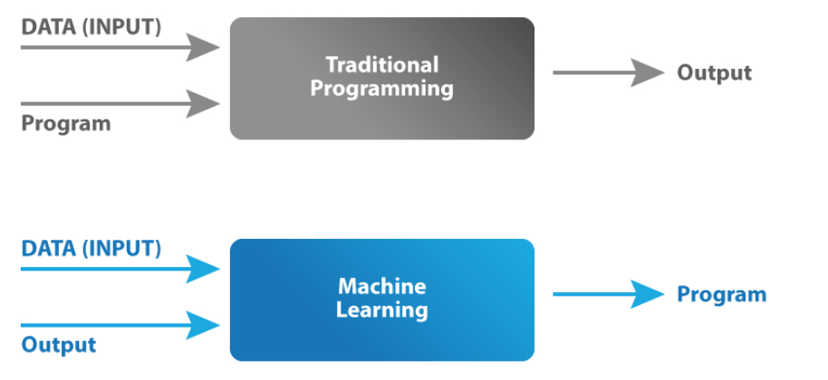
How does machine learning work
Machine learning is incredibly complex and how it works varies depending on the task and the algorithm used to accomplish it. However, at its core, a machine learning model is a computer looking at data and identifying patterns, and then using those insights to complete its assigned task more effectively. Any task that relies upon a set of data points or rules can be automated using machine learning.

Slide 4
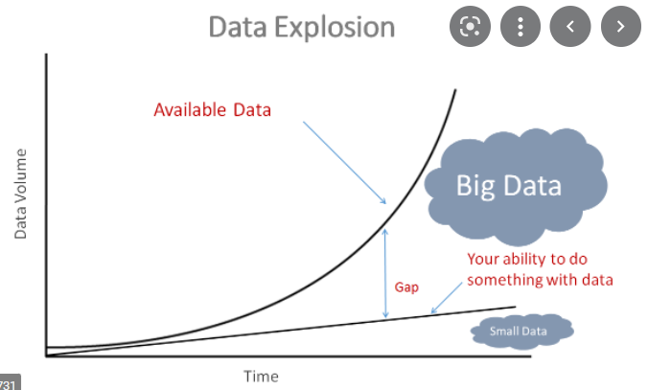
How is machine learning so successful today.?
Huge amount of data
As the amount of
available data increased
All the machine learning
Models were able to
Learn more about
Patterns to a particular
question

Slide 5
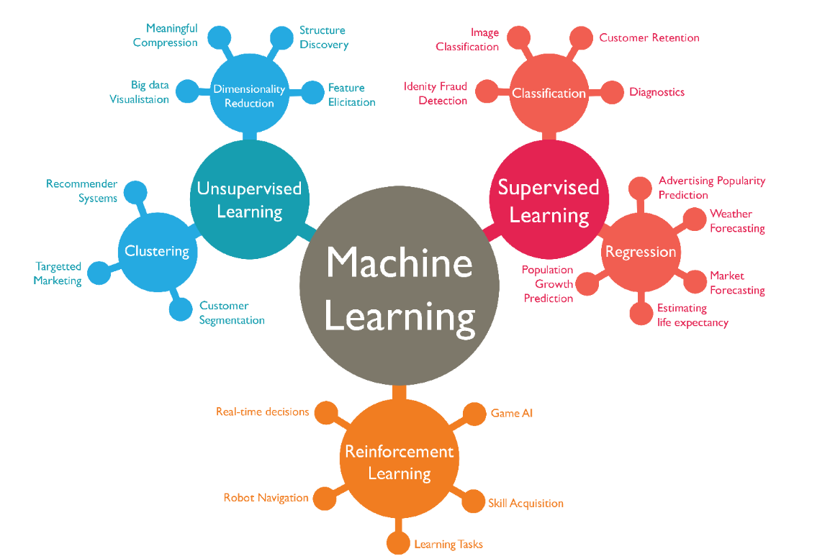
Classification in machine learning

Slide 6
Supervised learning
When an algorithm learns from example data and associated target responses that can consist of numeric values or string labels, such as classes or tags, in order to later predict the correct response when posed with new examples comes under the category of Supervised learning.
Example:This approach is indeed similar to human learning under the supervision of a teacher. The teacher provides good examples for the student to memorize, and the student then derives general rules from these specific examples.

Slide 7
Unsupervised Learning
when an algorithm learns from plain examples without any associated response, leaving to the algorithm to determine the data patterns on its own. This type of algorithm tends to restructure the data into something else, such as new features that may represent a class or a new series of un-correlated values. They are quite useful in providing humans with insights into the meaning of data and new useful inputs to supervised machine learning algorithms.
Example:Customer segmentation, or understanding different customer groups around which to build marketing or other business strategies.

Slide 8
Reinforcement learning
When you present the algorithm with examples that lack labels, as in unsupervised learning. However, you can accompany an example with positive or negative feedback according to the solution the algorithm proposes comes under the category of Reinforcement learning, which is connected to applications for which the algorithm must make decisions (so the product is prescriptive, not just descriptive, as in unsupervised learning), and the decisions bear consequences. In the human world, it is just like learning by trial and error.
Example: Robotics for industrial automation.

Slide 9

Libraries used for machine learning
Scikit-learn (formerly scikits.learn and also known as sklearn) is a free software machine learning library for the Python programming language.^{[3]} It features various classification, regression and clustering algorithms including support-vector machines, random forests, gradient boosting, k-means and DBSCAN, and is designed to interoperate with the Python numerical and scientific libraries NumPy and SciPy

Slide 10

Tensor flow
TensorFlow is an open-source library developed by Google primarily for deep learning applications. It also supports traditional machine learning.
TensorFlow works on the basis of data flow graphs that have nodes and edges. As the execution mechanism is in the form of graphs, it is much easier to execute TensorFlow code in a distributed manner across a cluster of computers while using GPUs.

Slide 11
Developments in area of machine learning
Voice Assistant
Personalised Marketing
Fraud Detection
Self-Driving Cars
Predicting Behaviour
Healthcare
Process Automation
Chatbots

